Slide 1
Title of Paper: Interruption flows for evaluating the reliability of power distribution networks
MATH3205 Project Introduction
Jack Buchanan, Clancy Heyworth, Blake Tucker
Tuesday 26th Aug

Slide 2
Problem Background
Distribution networks: Transport electricity from transmission networks to end-use customers
Power interruptions: 70% of power supply downtime originates from faults in the distribution network
Possible solutions:
Maintenance of electrical components
Location of response teams
Allocation of energy storage devices
Power reconfiguration via switch control
Problem: Limited CAPEX means that investment opportunity is dictated by the reliability of each method i.e the ability of each method to reduce loss of power incidents the most
Description: The paper considers a fixed number of switches and their placement to minimize the duration of interruptions
- Establishes LP architecture to evaluate the reliability of the other solutions above

Slide 3
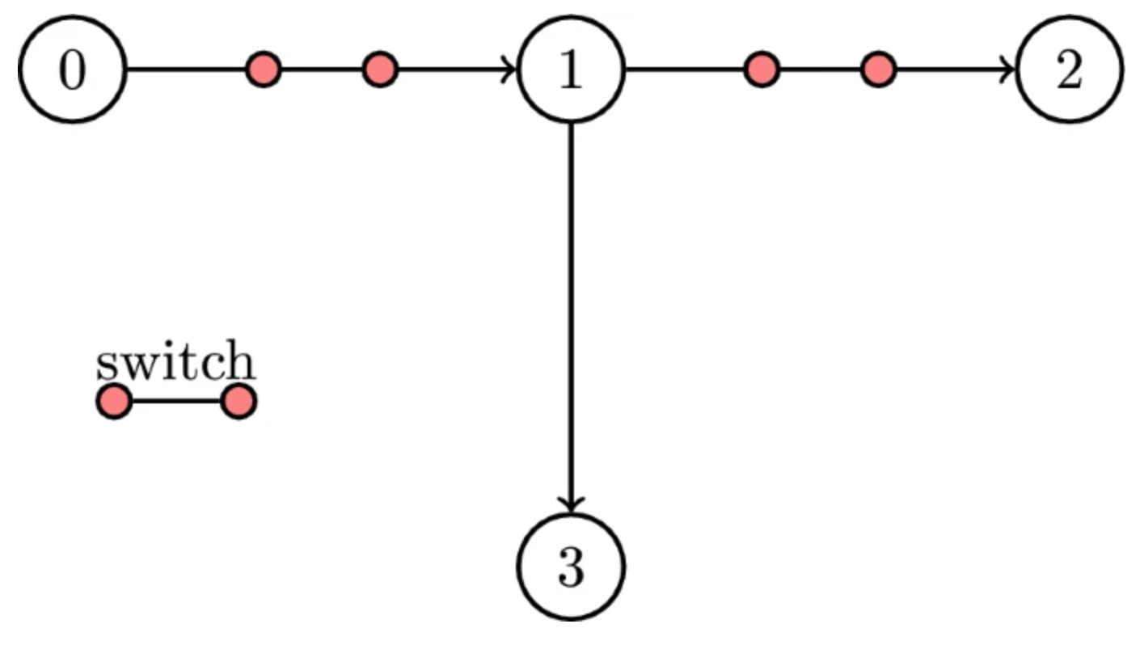
Network Configuration
Node 0 represents the sub-station
Switch in closed position allowing current to flow
Opens when overcurrent detected i.e short-circuit
Otherwise nodes denote a load point for control or consumption of power

Slide 4
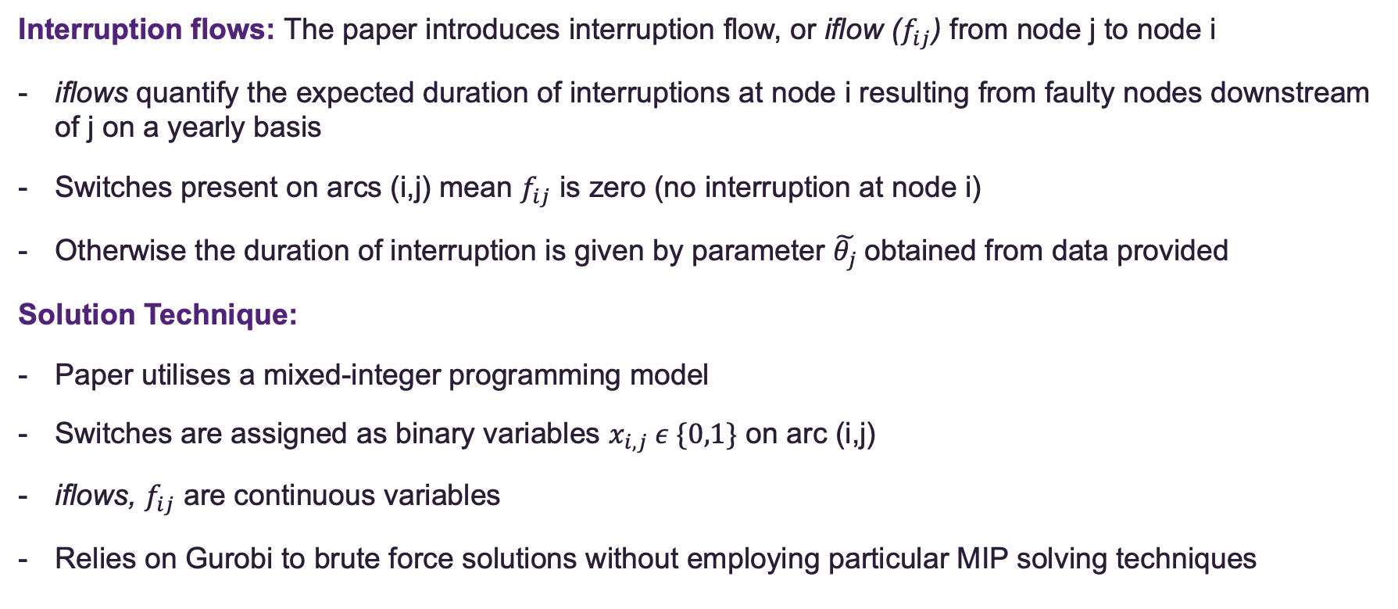
Problem Solution
Interruption flows: The paper introduces interruption flow, or iflow ($f_{ij}$) from node j to node i
iflows quantify the expected duration of interruptions at node i resulting from faulty nodes downstream of j on a yearly basis
Switches present on arcs (i,j) mean $f_{ij}$ is zero (no interruption at node i)
Otherwise the duration of interruption is given by parameter $\tilde{θ_{j}}$obtained from data provided
Solution Technique:
Paper utilises a mixed-integer programming model
Switches are assigned as binary variables $x_{i,j} ε \{0,1\}$ on arc (i,j)
iflows, $f_{ij}$ are continuous variables
Relies on Gurobi to brute force solutions without employing particular MIP solving techniques

Slide 5
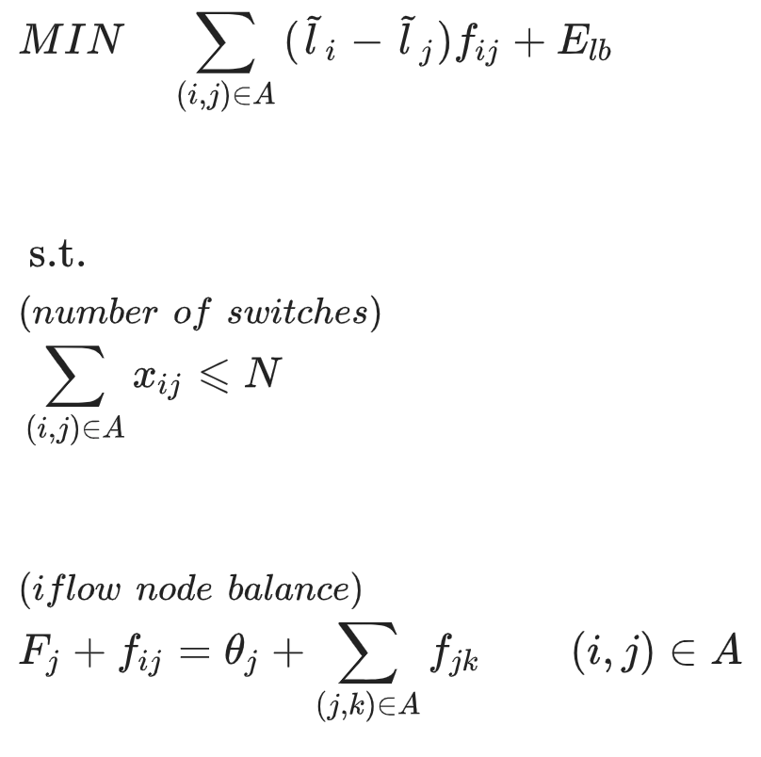
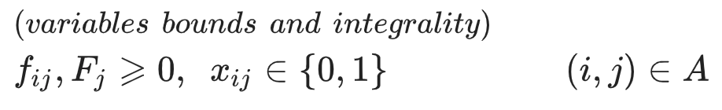
The Formulation
Obj. function minimizes energy not supplied to the end-use customer
Constrains the number of switches present in the network
Conservation of iflow coming into and going out of node j
Non-negative/trivial solutions

Slide 6
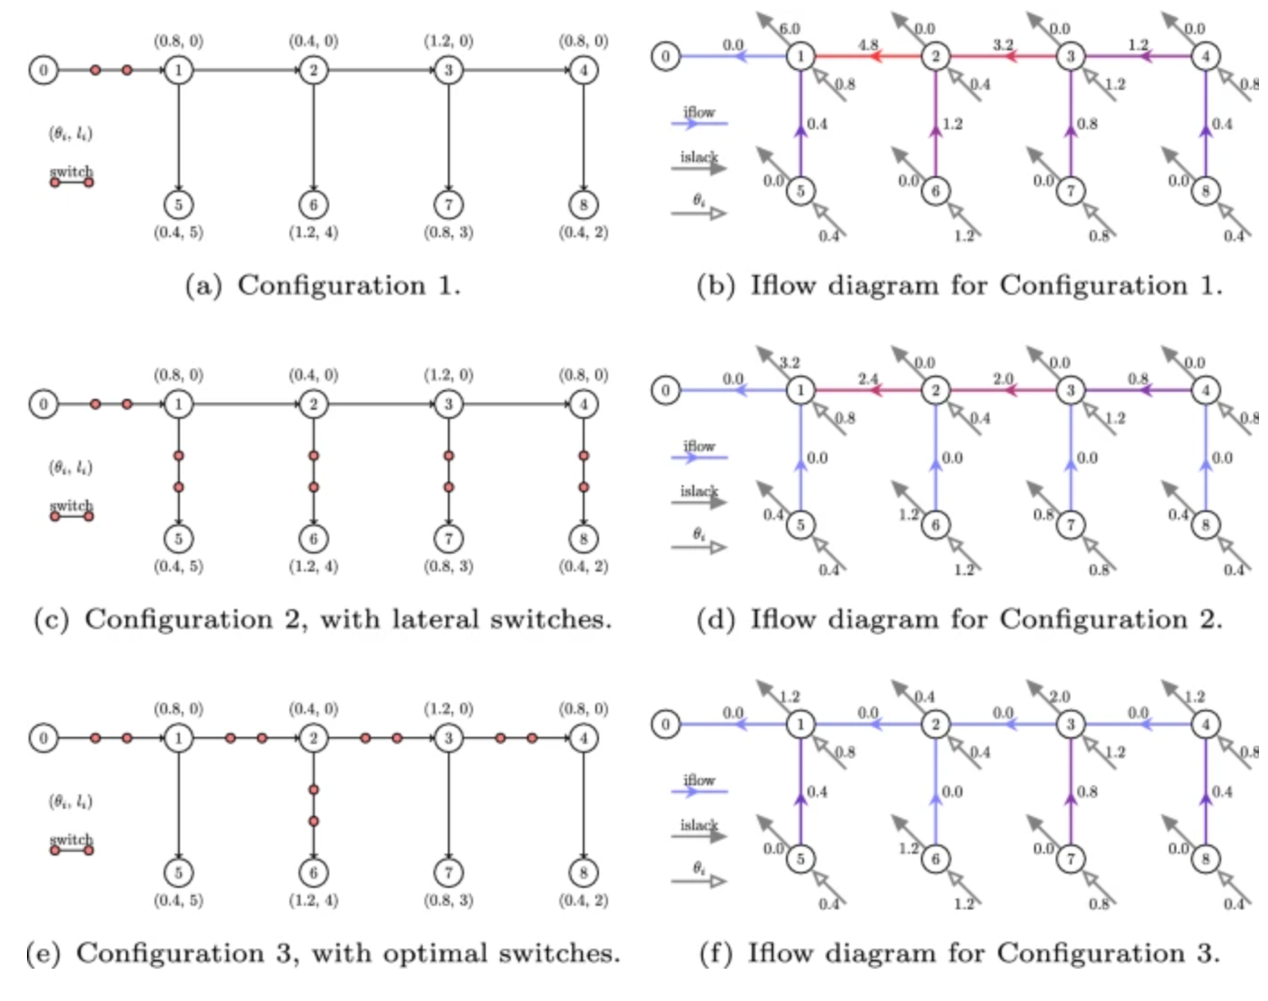
Modelled Configurations

Slide 7
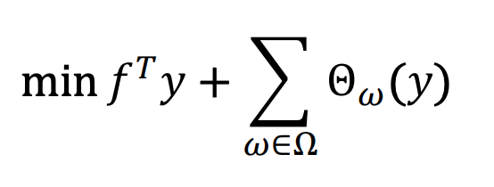
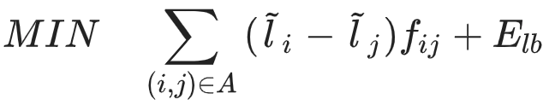
Improving The Model
Benders Decomposition: Switches as binary variables and iflows as continuous variables ➔ decomposition into master and sub-problem
Note that the master problem is implicitly evaluated inside the objective function
Implementation: Given a fixed number of switches an initial switch configuration will be supplied
The sub-problem (S.P) will then be evaluated to determine the duration of interruption from iflows
Iterating various configurations the S.P will be continually evaluated using a Callback until a solution is found
The improvement: Using Benders technique, time until optimality can be drastically reduced when compared to the current model

Slide 8
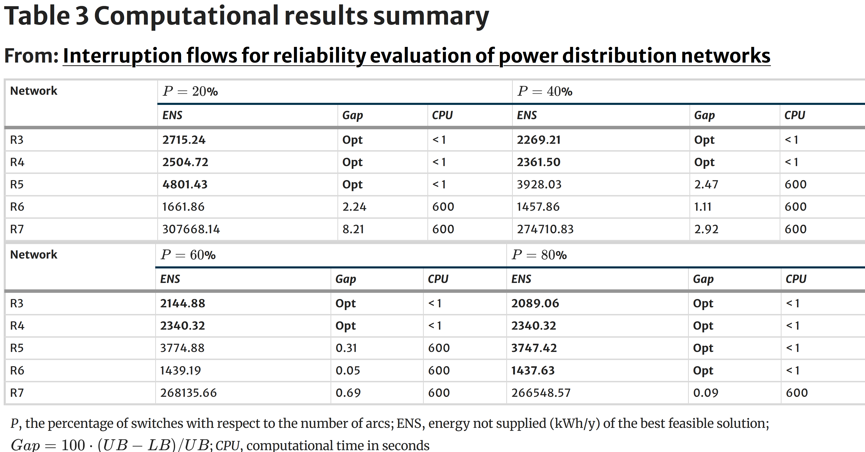
Paper Results
Authors of paper used maximum of ten minutes for optimization with Intel i7 3930k
Did not achieve optimality for several variations of larger networks
Goal for improvement from paper would be to be able to reach optimality in these cases within the time frame

Slide 9
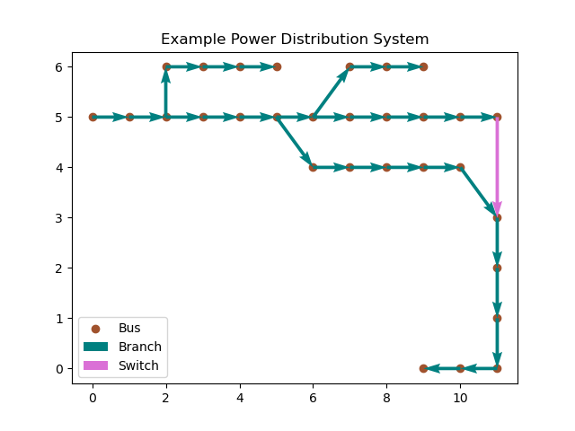
Supplied Data
Source: data used is directly obtained from the paper itself, which provides information on the estimated interruption times and other parameters involved in the model.
Graph of a Power Distribution System in Paper Data

Slide 10
References
Electricity Supply Chain | AEMC. Available at: https://www.aemc.gov.au/energy-system/electricity/electricity-system/electricity-supply-chain (Accessed: 24 August 2024).
Supporting Paper:
Usberti, F.L., Cavellucci, C. & Lyra, C. Interruption flows for reliability evaluation of power distribution networks. Oper Res Int J 23, 4 (2023). https://doi.org/10.1007/s12351-023-00758-w

